Slide 1

Machine Learning
Ad Recommendation System using Machine Learning
Group 3 – Final Project
Link to the recorded presentation: https://youtu.be/5ibOdOsvZOM

Slide 2

Professor: Babatunde Giwa
Vani
Shreya
VIKASH
jAVID
sHIVRAJ

Slide 3

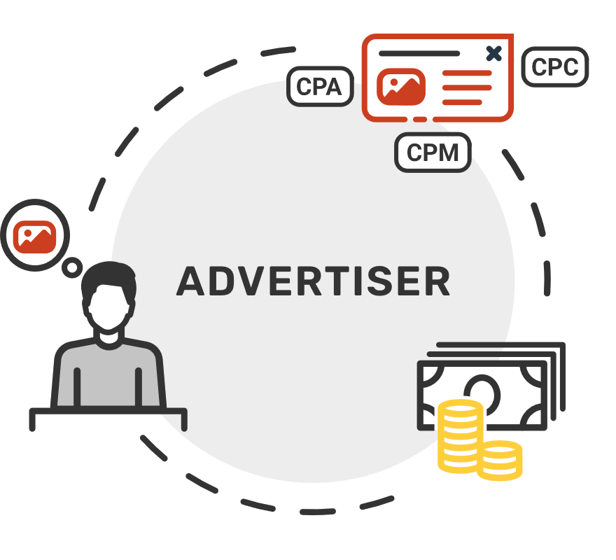
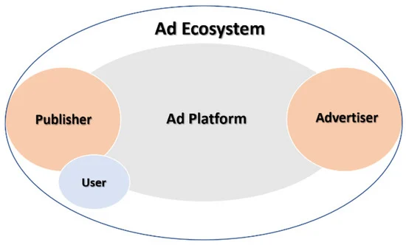
Advertising System – The Business Model

Slide 4

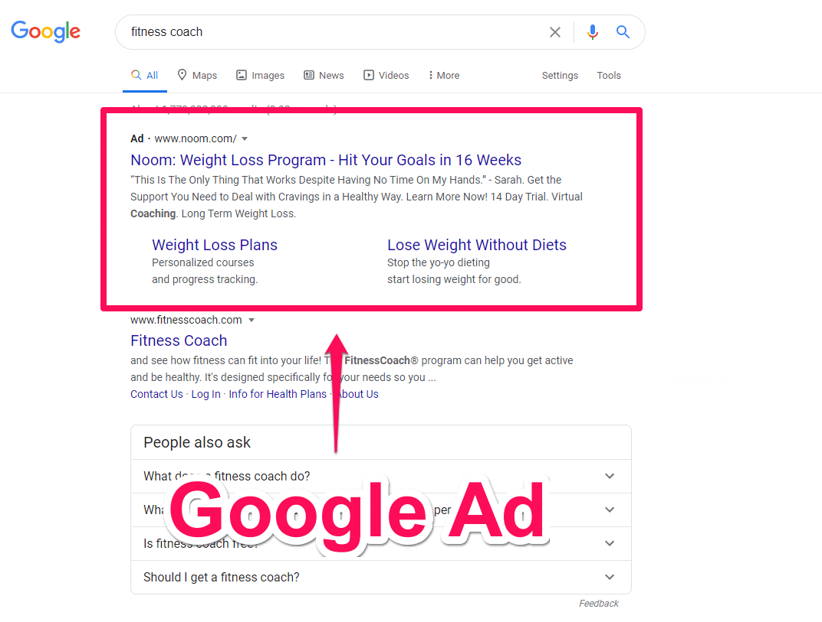
Ad system – Example – Google Ads

Slide 5

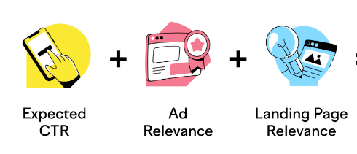
Advertising system – The problem
Serving highly relevant ads to the users
Objective
Maximize Revenue for the Publishers (website owners)
Maximize Return on Ad spend for the advertisers

Slide 6

Serving Relevant Ads – The General approach for Ad systems
Crawl the web pages to get the textual content – Titles, Description, Textual Content, Alt text from the images and index them
Index the words from the Advertisers ads – Title, Description, etc.
Find relevance by matching the keywords from the web pages and ads and create a mapping based on relevance score
Serve ads and monitor the performance

Slide 7
Data Preprocessing – Preparing the data for quality
Lower case the content, remove numbers and punctuations, trailing spaces, etc.
word_tokenize >> To split the sentence in a list of words
Remove non alphabetic tokens
Filter out stopwords
Lemmatize the words

Slide 8
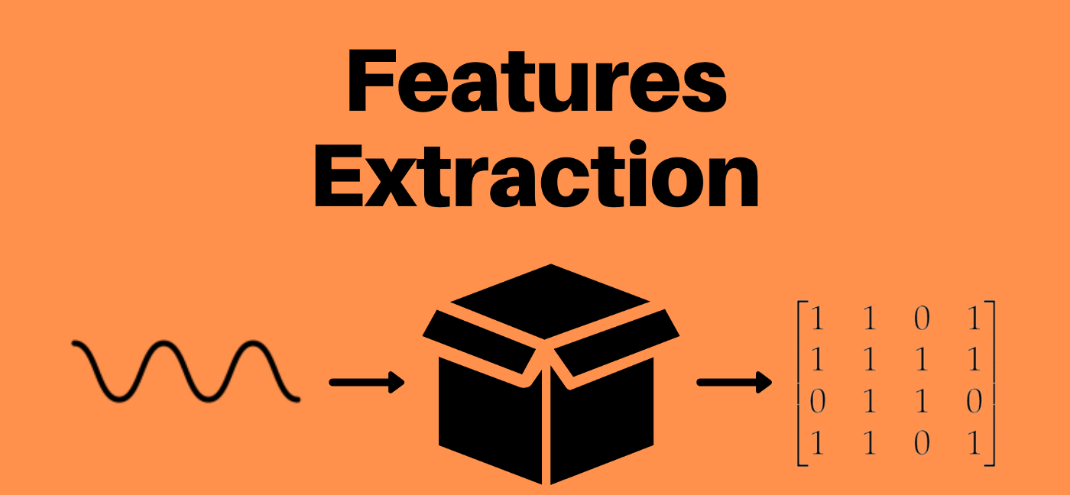
Serving Relevant Ads – Feature extraction
Extract Features in a format supported by machine learning algorithms
In other words, refers to the process of transforming raw data into numerical features that can be processed while preserving the information in the original data set
Yields Better results than applying machine learning directly to the raw data

Slide 9
Feature extraction using TFIDF
One of the most popular IR(Information Retrieval) technique to analyze how important a word is in a document.
TF-IDF weighs the importance of words in a document.
It combines 2 concepts, Term Frequency (TF) and Document Frequency (DF)
The term frequency is the number of occurrences of a specific term in a document. Term frequency indicates how important a specific term in a document.
Inverse document frequency (IDF) is the weight of a term, it aims to reduce the weight of a term if the term’s occurrences are scattered throughout all the documents.
The TF-IDF score as the name suggests is just a multiplication of the term frequency matrix with its IDF

Slide 10
SKlearn - TFIDF Vectorizer
Sklearn > feature_extraction module > text sub module > TfidfVectorizer class
Convert a collection of raw documents to a matrix of TF-IDF features
STEPS for Training the model (using web content data):
Initialize TfidfVectorizer – with different set of parameters (The parameters change the way the TFIDF is calculated.
Recommended way:
With smoothing (smooth_idf = True)
Apply fit_transform on the training data
Get the unique word tokens from the documents using get_feature_names_out() method

Slide 11
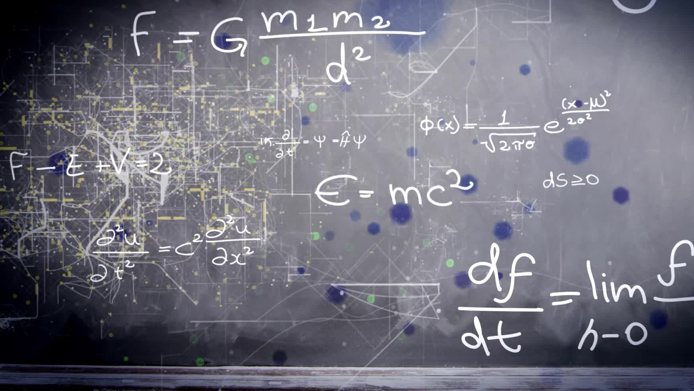
Sklearn – TFIDF Vectorizer continued
STEPS for mapping the content tfidf with the ad data:
Fit the vectorizer with the tfidf matrix corpus
Transform the new vectorizer vector with the ad data
Get the cosine_similarity between the two matrices (the content matrix and the ad matrix)

Slide 12
Cosine_similarity
Mathematically, Cosine similarity metric measures the cosine of the angle between two n-dimensional vectors projected in a multi-dimensional space.
The Cosine similarity of two documents will range from 0 to 1. If the Cosine similarity score is 1, it means two vectors have the same orientation.
The value closer to 0 indicates that the two documents have less similarity.
In our example, we first converted text into numbers to be able to represent into vectors.
Each term has its own axis in space, A word is represented into a vector form. The text documents are represented in n-dimensional vector space.

Slide 13
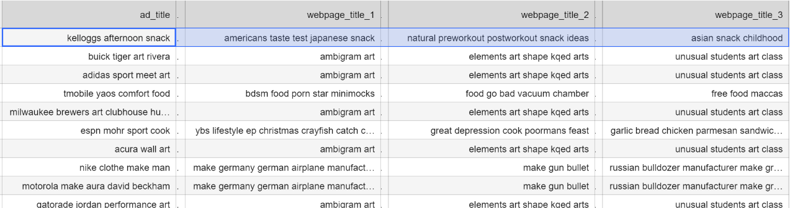
Ad mapping with the Web pages Result

Slide 14
Thank You

